Slide 1

A Compensation Method of Two-stage Image Generation for Human-AI Collaborated In-situ Fashion Design in Augmented Reality Environment
Zhenjie Zhao, Xiaojuan Ma
Human-Computer Interaction Initiative
Hong Kong University of Science and Technology
Dec 10, 2018, Taichung
Notes:
Hello everyone, my name is Zhenjie Zhao. I am a PhD student from HCI initiative of HKUST. Our paper is XXX. This work is collaborated with my supervisor …

Slide 2
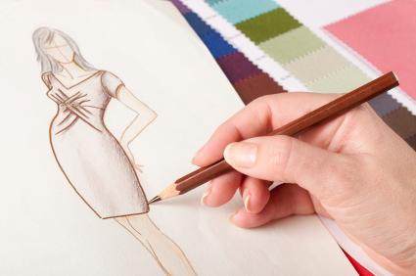
Background: Fashion Design
Sketching is usually the first step in garment manufacture (Ma et al., 2011)
(Early stage fashion design, image from web)
Notes:
For fashion design, sketching is …

Slide 3
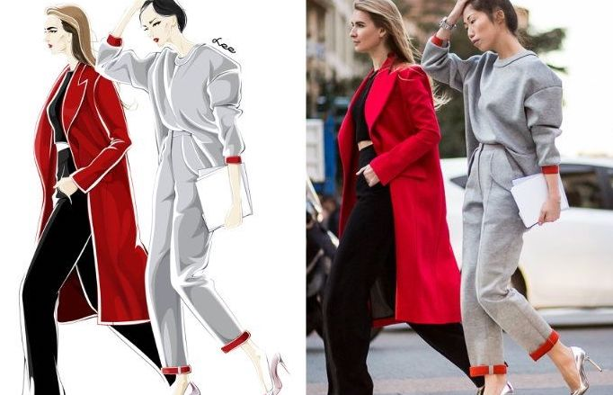
Background: Fashion Design
A long-standing practice in fashion industry (Kaiser et al., 1991)
Integrate elements from subculture
Adapt marketable looks on the street
(Design with street snap, image from web)
Notes:
A long-standing practice in …

Slide 4
Background: Fashion Design
Sketching is usually the first step in garment manufacture (Ma et al., 2011)
A long-standing practice in fashion industry (Kaiser et al., 1991)
Integrate elements from subculture
Adapt marketable looks on the street
For entertainment and personal sense-making, how could we help novices acquire this skill?
Barrier: drawing & design ideas
Examples, font design (Devendorf et al., 2013), fabrication (Bousseau et al., 2016)
Notes:
However, for entertainment and personal sense-making purposes, how could we help novices acquire this skill, where novices usually are not good at drawing and forming design ideas. Previously works have explored font design, fabrication, and so on, and we will try to address it for fashion design.

Slide 5
Idea: Design with AI
Machine learning as a design material (Dove et al., 2017)
Designers collaborate with algorithms
Design with AI¹ (Hebron et al., 2016)
Fully automatic (lose authorship ☹️)
Manually tuning (hard for novices ☹️)
Our solution
Human-AI collaboration (easy to use 😀, authorship 😀)
1. AI: trained machine learning models
Notes:
Our idea is by using AI technology for design. Machine learning as a design material has been explored by researchers recently. Here AI we means … In general, there are two paradigms of design with AI: …… Our solution is to try to make human collaborate with AI together, and therefore benefits both approaches.

Slide 6
Design Requirements
R1. Adapt marketable looks on the street
R2. Sense of collaboration
R3. Easy to integrate elements from subculture
Notes:
From the problem, we formulate three design requirements: …

Slide 7
Contributions
We consider a novel human-AI collaboration fashion design task in AR environment
From viewpoint of system engineers, we propose a compensation method, and design a corresponding GAN model
We design and implement a system, and evaluate it through several studies

Slide 8
Our System Design
Sketch-based augmented reality (AR) application
AR mode: adapt marketable looks on the street (R1)
(image mode)
(AR mode)
Notes:
In particular, we design an AR application to help users adapt …. In addition, users can also use the image mode for design.

Slide 9
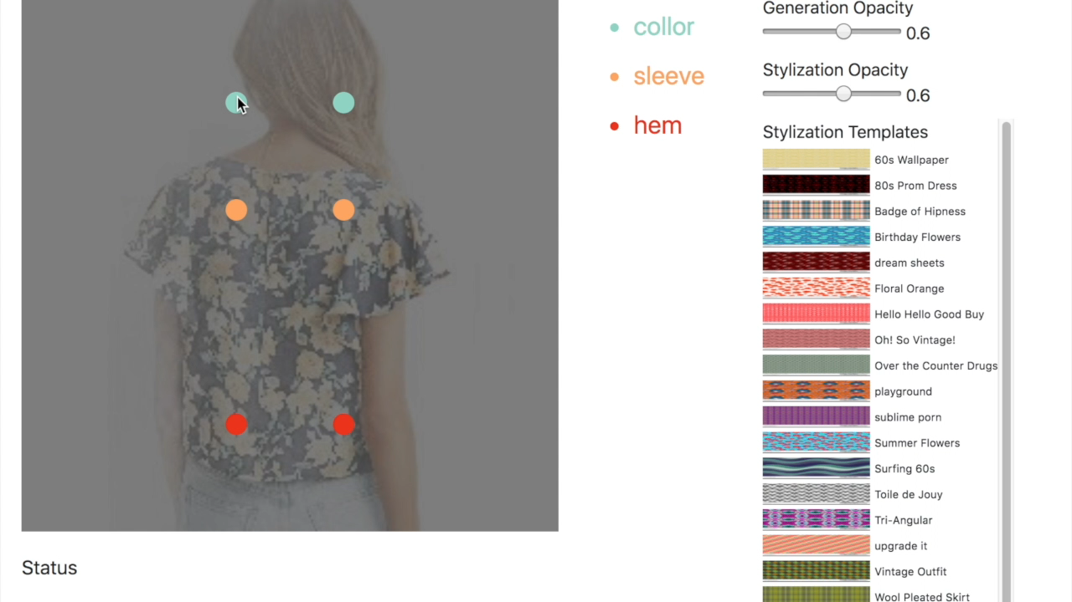
Our System Design (cont.)
Sketch-based augmented reality (AR) application
Generative design: human-AI collaboration with compensation (R2)
Notes:
And for human-AI collaboration, we use a recent proposed generative model. And for more smooth collaboration with this model, we propose a compensation method to help users design more effectively. I will present this method in more details later. Now let me show you a video how it works.
First, with a reference image, users first need to adjust the clothing landmarks, which is a relative easy task, and we use this input to generate a compensation signal.
Then users sketch clothing contour on it, together with the compensation signal, we can generate a better result. In addition, we also provide a color transfer function, where users can transfer different color patterns onto the final design. Users can design iteratively. And with the compensation method, the final output is relatively easy to control.

Slide 10
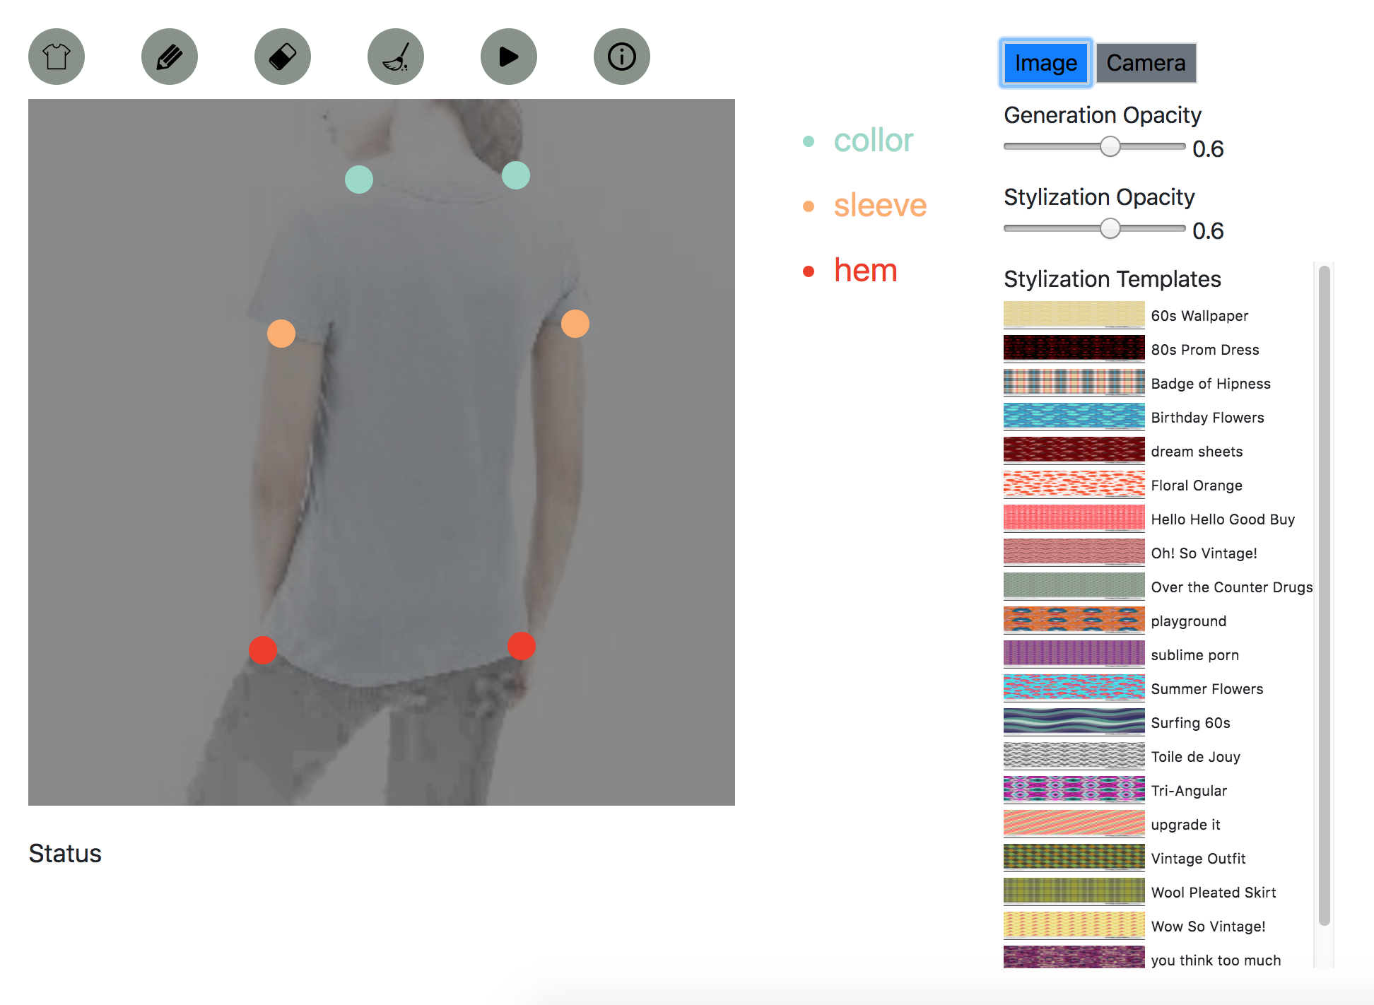
Our System Design (cont.)
Sketch-based augmented reality (AR) application
Integrate elements from subculture (R3)
(color pattern transfer, Huang et al., 2017)
Notes:
As shown previously, we have a color transfer function that allows users to transfer color patterns onto the final designs, which can help users integrate elements from subculture easily.

Slide 11
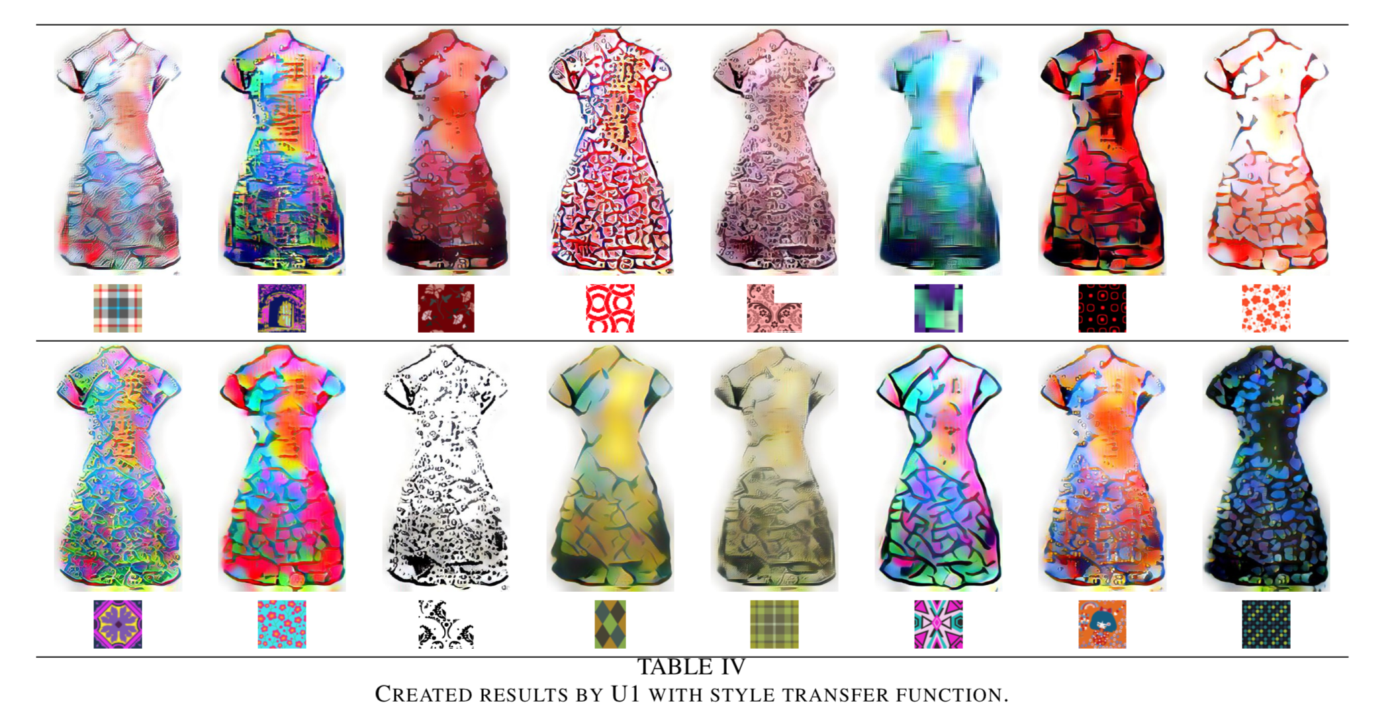
Example Results with Color Pattern Transfer
(with 3D effects)
Notes:
Given different color patterns, here are some example design results.

Slide 12
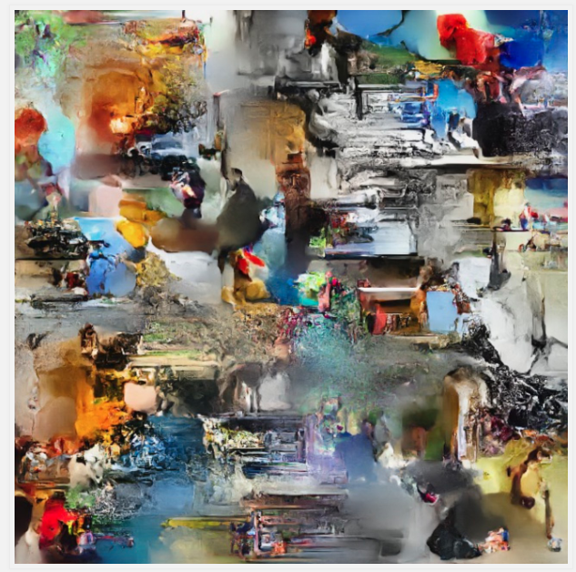
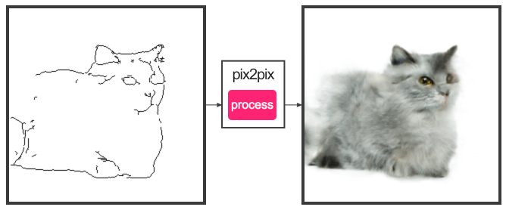
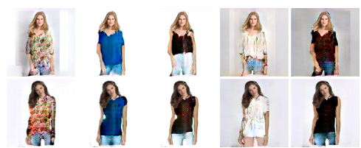
Generative Model: conditional Generative Adversarial Networks (cGAN)
(pix2pix, Isola et al., 2016)
(NIPS 2017 Art Gallery)
(FashionGAN, Zhu et al., 2017)
Notes:
For the generative model design, we used generative adversarial network, or GAN. Generative Adversarial Networks, or in particular, conditional generative adversarial network, has become a popular model for generative art recently. Our work is based on the pix2pix network, which can translate an image from one domain to another domain with the trained generative network.

Slide 13
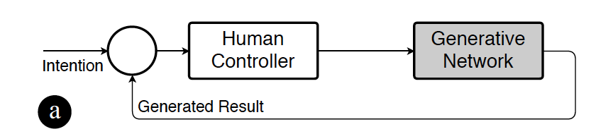
Generative Model with Compensation
unpredictable
(system point of view, Hu et al., 2007)
Notes:
We take inspiration from system theory to approach this problem. In particular, we look at it as an control problem, where in (a), human try to control the generative network to produce output, and look at the result to adjust the input. However, due to the problem of we usually cannot predict the result of GAN, we design an compensator to compensate the input of humans, which ideally can produce more reliable output.

Slide 14
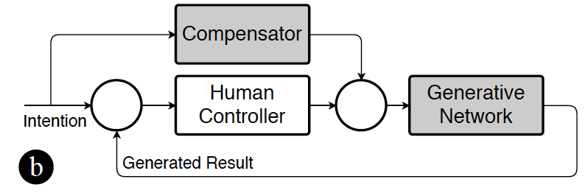
Generative Model with Compensation (cont.)
easy task, e.g., tuning landmarks
Notes:
We take inspiration from system theory to approach this problem. In particular, we look at it as an control problem, where in (a), human try to control the generative network to produce output, and look at the result to adjust the input. However, due to the problem of we usually cannot predict the result of GAN, we design an compensator to compensate the input of humans, which ideally can produce more reliable output.

Slide 15
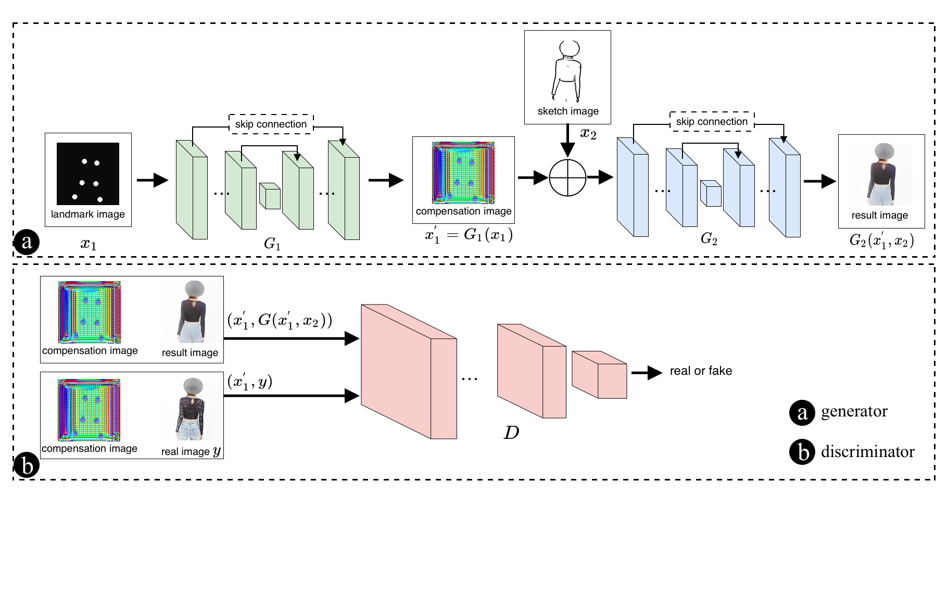
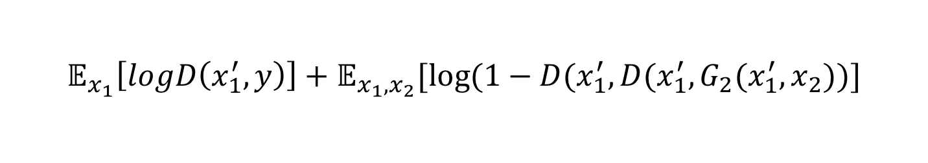
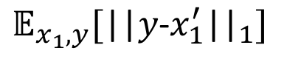
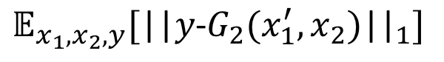
Generative Model with Compensation (cont.)
(modified based on pix2pix, Isola et al., 2016)
$${argmin}_{G_{1},G_{2}}{argmax}_{D}L_{cGAN}\left(G_{1},G_{2},D\right)+λ_{1}L_{1}\left(G_{1}\right)+λ_{2}L_{1}\left(G_{2}\right)$$
$$𝔼_{x_{1},x_{2},y}[{\text{||}y\text{−}G_{2}(x_{1}^{′},x_{2}\text{)}\text{||}}_{1}]$$
$$𝔼_{x_{1}}\left[logD\left(x_{1}^{′},y\right)\right]+𝔼_{x_{1},x_{2}}[log⁡(1−D(x_{1}^{′},D(x_{1}^{′},G_{2}(x_{1}^{′},x_{2}))]$$
$$𝔼_{x_{1},y}[{\text{||}y\text{−}x_{1}^{′}\text{||}}_{1}]$$
Notes:
Designing architecture of deep neural network is hard. We simply use existing generative network, and tune it to work. In particular, we first use the landmarks to generate a compensation signal, and concatenate it with a sketch image to generate the final output. During training, we compare two image pairs are the same or not, namely, the compensation signal with the generated output, or the ground-truth image.

Slide 16
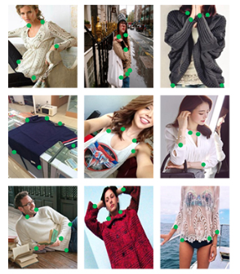
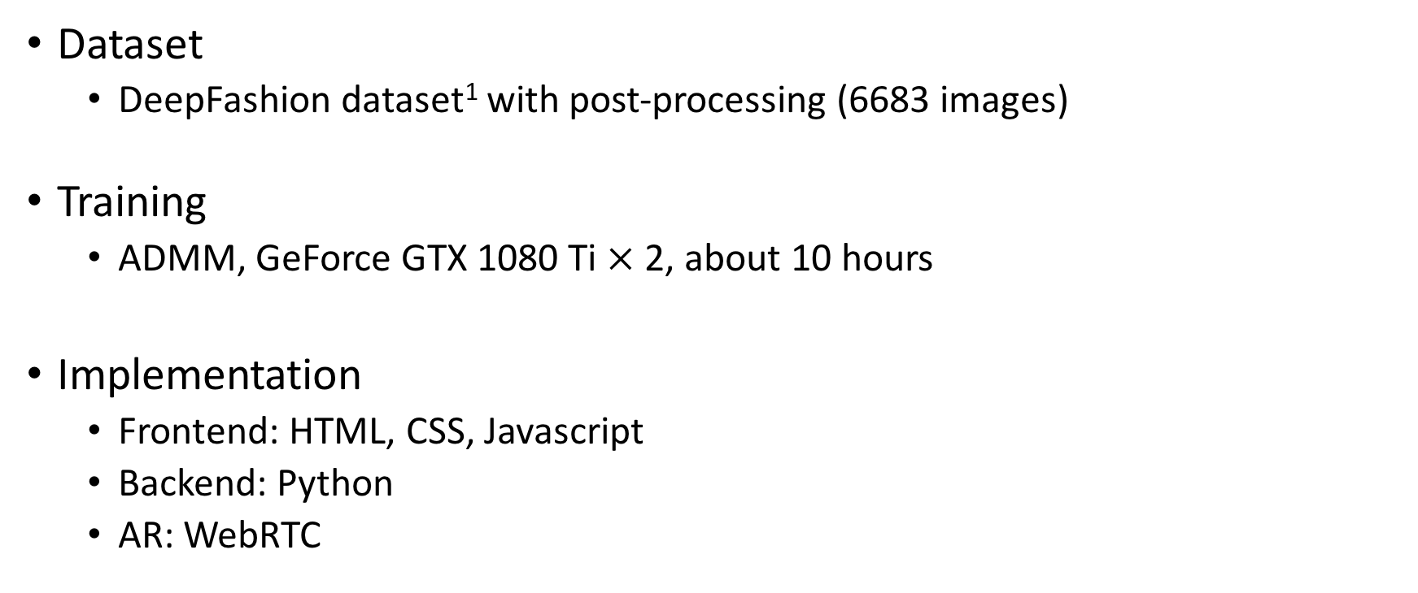
Experiment: Implementation Details
Dataset
DeepFashion dataset¹ with post-processing (6683 images)
Training
ADMM, GeForce GTX 1080 Ti $×$ 2, about 10 hours
Implementation
Frontend: HTML, CSS, Javascript
Backend: Python
AR: WebRTC
(DeepFashion, Liu et al., 2016)
1. http://mmlab.ie.cuhk.edu.hk/projects/DeepFashion.html
Notes:
We use a small part of the deepfashion dataset, and trained it on a station with two 1080 GPU. It converged in about 10 hours. And for the system, we implement it as client-server architecture, and use WebRTC to get live videos. Please see the paper for details.

Slide 17
Experiment: User Evaluation
Usability of the system
Online
46 participants on Amazon Mechanical Turk (AMT, 22 females, mean age 32, STD: 10.5, no background on design)
Offline
3 participants (1 professional designer)
Result comparison
Baseline: pix2pix (Isola et al., 2016)
Quantitative comparison
460 batches on Amazon Mechanical Turk
Qualitative comparison
68 participants on WJX¹
1. https://www.wjx.cn/
Notes:
We evaluate the method and the system through an online study and an offline study separately. The online study is used to test the general usability, comparison of generated results with our method and pix2pix, and the particular perceptual difference. The offline study is a more focused qualitative study.

Slide 18
Experiment: Usability of the system
Online study
On a 7-point Likert scale, usability 5.20 (STD: 1.42), user experience 4.98 (STD: 1.45)
Offline study
The collaboration approach is acceptable, and the AR mode is inspiring
More flexibility, like color transfer, etc., is expected
“Usually I prefer to draw something myself from scratch because it is more flexible for me to control the shape, texture, color, and so on. However, if I can refer to a live model in AR environment that fits my aesthetics, I would prefer to this way more to inspire my creation and imagination.”–(U1, professional graphics designer)
“I expect the system can allow me to transfer some color patterns of photos to my design, to decorate it with more flexibility.”–U1

Slide 19

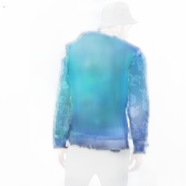

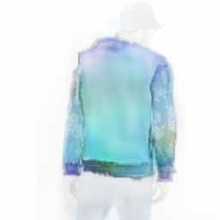
Experiment: Result Comparison
Quantitative comparison
Compared to pix2pix
460 comparisons on AMT
300 selected results with our method
Notes:
Explain what the figures are, bigger, two slides, 3D effects,
In the second experiment, out of 460 results, 300 select out method. And for the detailed comparison, we find that people like our method because they are “softer”, more “textured”, and “clear”, while people like pix2pix because they are “bright”, “saturated”.

Slide 20
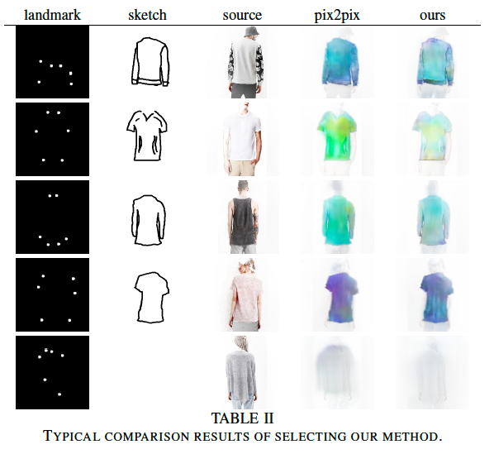
Experiment: Result Comparison
Qualitative comparison
Choose ours: “softer”, more “textured”, and “clearer”
Notes:
Explain what the figures are, bigger, two slides, 3D effects,
In the second experiment, out of 460 results, 300 select out method. And for the detailed comparison, we find that people like our method because they are “softer”, more “textured”, and “clear”, while people like pix2pix because they are “bright”, “saturated”.

Slide 21
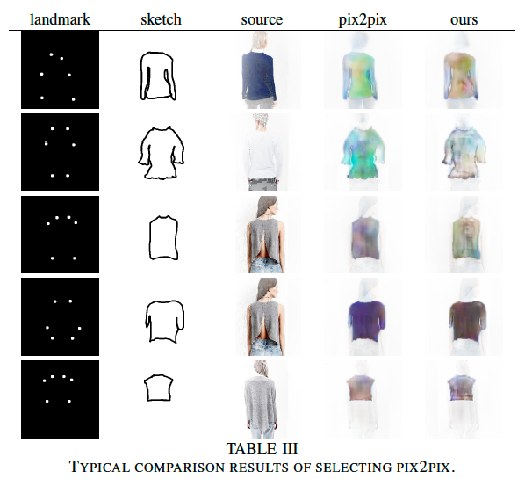
Experiment: Result Comparison
Qualitative comparison
Choose pix2pix: “brighter”, “more saturated”
Notes:
Explain what the figures are, bigger, two slides, 3D effects,
In the second experiment, out of 460 results, 300 select out method. And for the detailed comparison, we find that people like our method because they are “softer”, more “textured”, and “clear”, while people like pix2pix because they are “bright”, “saturated”.

Slide 22
Limitation
Technical part
Only a simple compensation method is considered
AR system functions, e.g., object tracking, camera jitter, etc., are not considered
Theory: human-AI collaboration
How can AI better sense humans’ states, e.g., emotion, and provide more intelligent feedback
Notes:
Our primary work is still quite limited. For example, we could further improve the cGAN model, and also enrich the AR application. In addition, in the theory part, how could AI collaborate with humans efficiently is also an important question needed to be addressed.

Slide 23
Summary
We consider a novel human-AI collaboration fashion design task in AR environment
From viewpoint of system engineers, we propose a compensation method, and design a corresponding GAN model
We design and implement a system, and evaluate it through several studies

Slide 24

Thank You ~
demo session
Tue, Dec 11, 13:40-16:00
Zhenjie Zhao @ HCI HKUST
Email: zzhaoao@cse.ust.hk
source code, ppt, etc.

Slide 25
References
[1] R. T. Azuma, “A survey of augmented reality,” Presence: Teleoper. Virtual Environ., vol. 6, no. 4, pp. 355–385, Aug. 1997. [Online]. Available: http://dx.doi.org/10.1162/pres.1997.6.4.355
[2] W. Shi, Z. Wang, M. Sezgin, J. Dorsey, and H. Rushmeier, “Material design in augmented reality with insitu visual feedback,” in Eurograph- ics Symposium on RenderingExperimental Ideas & Implementations, M. Zwicker and P. Sander, Eds. The Eurographics Association, 2017.
[3] S. Bu ̈ttner, H. Mucha, M. Funk, T. Kosch, M. Aehnelt, S. Robert, and C. Ro ̈cker, “The design space of augmented and virtual reality applications for assistive environments in manufacturing: A visual approach,” in Proceedings of the 10th International Conference on PErvasive Technologies Related to Assistive Environments, ser. PETRA ’17. New York, NY, USA: ACM, 2017, pp. 433–440. [Online]. Available: http://doi.acm.org/10.1145/3056540.3076193
[4] M. Mirza and S. Osindero, “Conditional generative adversarial nets,” in arXiv:1411.1784, 2014.
[5] P. Isola, J. Zhu, T. Zhou, and A. A. Efros, “Image-to-image translation with conditional adversarial networks,” in 2017 IEEE Conference on Computer Vision and Pattern Recognition (CVPR), July 2017, pp. 5967– 5976.
[6] A. Bousseau, T. Tsandilas, L. Oehlberg, and W. E. Mackay, “How novices sketch and prototype hand-fabricated objects,” in Proceedings of the 2016 CHI Conference on Human Factors in Computing Systems, ser. CHI ’16. New York, NY, USA: ACM, 2016, pp. 397–408. [Online]. Available: http://doi.acm.org/10.1145/2858036.2858159

Slide 26
References (cont.)
[7] A. Oulasvirta, X. Bi, and A. Howes, Computational interaction. Oxford University Press, 2018. [Online]. Available: https://books. google.com.hk/books?id=- r9EDwAAQBAJ
[8] A. D. Streeter, L. R. Ray, and R. D. Collier, “Hybrid feedforward- feedback active noise control,” in Proceedings of the 2004 American Control Conference, vol. 3, June 2004, pp. 2876–2881 vol.3.
[9] S. Hu, “Principle of automatic control,” in Beijing Science Press, 2007. [10] I. Goodfellow, J. Pouget-Abadie, M. Mirza, B. Xu, D. Warde-Farley, S. Ozair, A. Courville, and Y. Bengio, “Generative adversarial nets,” in Advances in neural information processing systems, 2014, pp. 2672–
2680. [11] Y. Li, X. Luo, Y. Zheng, P. Xu, and H. Fu, “Sweepcanvas: Sketch-based
3d prototyping on an rgb-d image,” in Proceedings of the 30th Annual ACM Symposium on User Interface Software and Technology, ser. UIST ’17. New York, NY, USA: ACM, 2017, pp. 387–399. [Online]. Available: http://doi.acm.org/10.1145/3126594.3126611
[12] L. Devendorf and K. Ryokai, “Anytype: Provoking reflection and exploration with aesthetic interaction,” in Proc. CHI’ 13, 2013, pp. 1041–1050. [Online]. Available: http://doi.acm.org/10.1145/2470654. 2466133

Slide 27
References (cont.)
[13] G. Dove, K. Halskov, J. Forlizzi, and J. Zimmerman, “Ux design innovation: Challenges for working with machine learning as a design material,” in Proc. CHI’ 17, 2017, pp. 278–288. [Online]. Available: http://doi.acm.org/10.1145/3025453.3025739
[14] J. McCormack, A. Dorin, T. Innocent et al., “Generative design: a paradigm for design research,” Proc. Futureground, Design Research Society, Melbourne, 2004.
[15] C. Ma, Y. Liu, H. Yang, D. Teng, H. Wang, and G. Dai, “Knitsketch: A sketch pad for conceptual design of 2d garment patterns,” IEEE Transactions on Automation Science and Engineering, pp. 431–437, 2011.
[16] D. A. Norman and R. Verganti, “Incremental and radical innovation: Design research vs. technology and meaning change,” Design Issues, pp. 78–96, 2014. [Online]. Available: https://doi.org/10.1162/DESI a 00250
[17] S. B. Kaiser, R. H. Nagasawa, and S. S. Hutton, “Fashion, postmoder- nity and personal appearance: A symbolic interactionist formulation,” Symbolic Interaction, pp. 165–185, 1991.
[18] K. Carlson, T. Schiphorst, K. Cochrane, J. Phillips, H. H. Tsang, and T. Calvert, “Moment by moment: Creating movement sketches with camera stillframes,” in Proc. 2015 ACM SIGCHI Conference on Creativity and Cognition, 2015, pp. 131–140. [Online]. Available: http://doi.acm.org/10.1145/2757226.2757237

Slide 28
References (cont.)
[19] D. Chaney and C. Goulding, “Dress, transformation, and conformity in the heavy rock subculture,” Journal of Business Research, pp. 155 – 165, 2016. [Online]. Available: http://www.sciencedirect.com/science/ article/pii/S0148296315003203
[20] M. Zhang, S. Andrew, and S. Gill, “Exploring fashion choice criteria for older chinese female consumers: A wardrobe study approach,” International Conference on Applied Human Factors and Ergonomics, vol. 587, pp. 109–121, 2017.
[21] O.Ronneberger,P.Fischer,andT.Brox,“U-net:Convolutionalnetworks for biomedical image segmentation,” in International Conference on Medicalimagecomputingandcomputer-assistedintervention. Springer, 2015, pp. 234–241.
[22] Z. Liu, P. Luo, S. Qiu, X. Wang, and X. Tang, “Deepfashion: Powering robust clothes recognition and retrieval with rich annotations,” in 2016 IEEE Conference on Computer Vision and Pattern Recognition (CVPR), June 2016, pp. 1096–1104.
[23] P.DollrandC.L.Zitnick,“Fastedgedetectionusingstructuredforests,” IEEE Transactions on Pattern Analysis and Machine Intelligence, vol. 37, no. 8, pp. 1558–1570, Aug 2015.
[24] D. P. Kingma and J. L. Ba, “Adam: Amethod for stochastic optimiza- tion,” in Proc. 3rd Int. Conf. Learn. Representations, 2014.

Slide 29
References (cont.)
[25] X. Huang and S. Belongie, “Arbitrary style transfer in real-time with adaptive instance normalization,” in 2017 IEEE International Conference on Computer Vision (ICCV), Oct 2017, pp. 1510–1519.
[26] T.StrothotteandS.Schlechtweg,Non-photorealisticcomputergraphics: modeling, rendering, and animation. Morgan Kaufmann, 2002.

